Slide 1

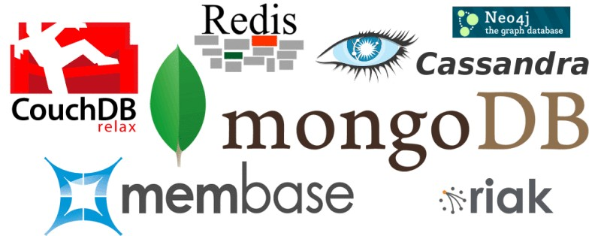
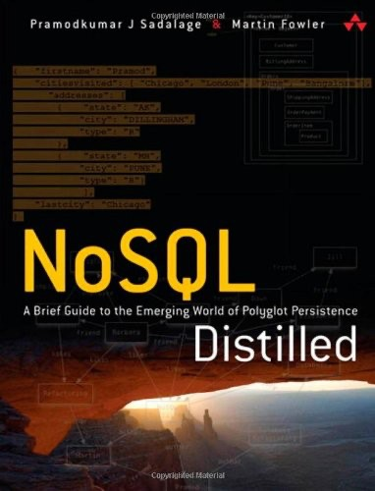
Column Oriented Database

Slide 2
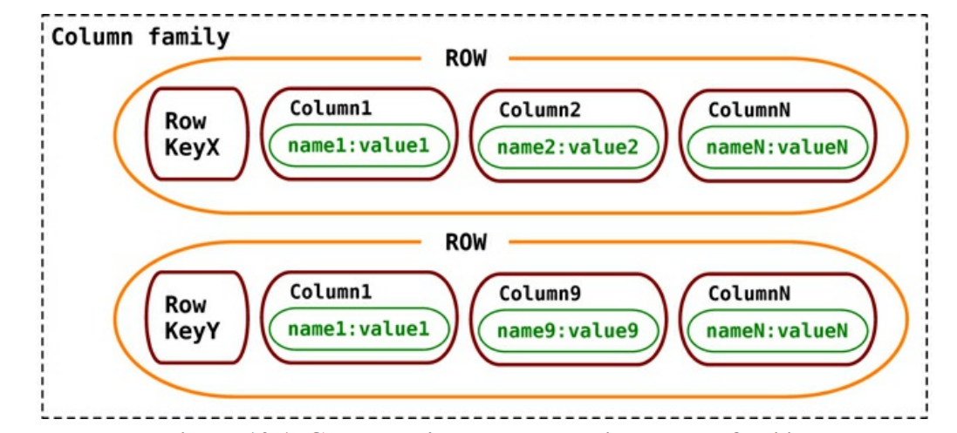
What is Column Store Database?
A column store database is a type of NoSQL database that stores data in columns rather than rows. A column store database organizes data by column rather than by row which allows for a more efficient storage of data and faster query performance. In a column store database, data is stored in a column-wise fashion, with all the values of a specific attribute stored together, which allows for faster data retrieval and compression.

Slide 3
Column Store Database
A column store database is well suited for data warehousing and business intelligence applications, where large amounts of data need to be analyzed and aggregated.
They are often used for analytical queries, such as aggregation and data mining, and are highly optimized for handling large datasets.
It’s also worth noting that some relational databases such as Vertica and MonetDB also have column store as an option.

Slide 4
Column Store Database Architecture
A column store database architecture typically comprises the following components:
Data storage layer: This is the layer where the actual data is stored, it can be on disk or in-memory. The data is organized in a column-wise fashion, with all the values of a specific attribute stored together, which allows for faster data retrieval and compression.
Query engine: This is the layer that processes queries and retrieves data from the storage layer. The query engine is optimized for performing complex analytical queries, such as aggregation and data mining.
Indexing layer: This layer creates indexes on the data, allowing for faster query performance. Column store databases often use column-level indexes, which are optimized for column-based data retrieval.

Slide 5
Column Store Database Architecture
Compression layer: This layer compresses the data to reduce storage space and improve performance. Column store databases often use advanced compression techniques such as run-length encoding or dictionary encoding.
Data loading layer: This layer is responsible for loading data into the database. Column store databases use specialized data loading techniques, such as bulk loading or incremental loading, to efficiently load large amounts of data.
Management and administration layer: This layer provides tools and interfaces for managing and administering the database, such as backup and recovery, performance monitoring, and security management.
Data replication layer: This layer is responsible for replicating the data to multiple nodes, this allows for high availability and scalability.

Slide 6
Column Store Database Examples
One example of a column store database is Apache Cassandra. Cassandra is an open-source, distributed, NoSQL database that stores data in a column-family format. Column families are similar to tables in a relational database, but they store data column-wise. Each column family in Cassandra has a set of rows, and each row has a set of columns. Each column has a name, value, and timestamp. The column names are grouped together, and this grouping is called a super column.
For example, consider a column family called “users” that stores information about users. The rows in the “users” column family could represent individual users, and the columns could represent different attributes of the user, such as name, age, and location. The data for each attribute would be stored together, in the same column, allowing for efficient data retrieval and compression.
Cassandra is designed for high availability and scalability, and it can handle large amounts of data and a high number of concurrent users. It is often used in applications that require high write throughput and low latency, such as online gaming, real-time analytics, and e-commerce

Slide 7
Column Store Database Features
The basic unit of storage in Cassandra is a column. A Cassandra column consists of a name-value pair where the name also behaves as the key. Each of these key-value pairs is a single column and is always stored with a timestamp value.
The timestamp is used to expire data, resolve write conflicts, deal with stale data, and do other things. Once the column data is no longer used, the space can be reclaimed later during a compaction phase.
Super column families are good to keep related data together, but when some of the columns are not needed most of the time, the columns are still fetched and deserialized by Cassandra, which may not be optimal.
Cassandra puts the standard and super column families into keyspaces. A keyspace is similar to a database in RDBMS where all column families related to the application are stored.
Some of the features for all the NoSQLdata stores are
consistency,
transactions,
availability
query features,
scaling.

Slide 8
Column Store Database Features - Consistency
When a write is received by Cassandra, the data is first recorded in a commit log, then written to an in-memory structure known as memtable. A write operation is considered successful once it’s written to the commit log and the memtable. Writes are batched in memory and periodically written out to structures known as SSTable. SSTables are not written to again after they are flushed; if there are changes to the data, a new SSTable is written. Unused SSTables are reclaimed by compactation.
Let’s look at the read operation to see how consistency settings affect it. If we have a consistency setting of ONE as the default for all read operations, then when a read request is made, Cassandra returns the data from the first replica, even if the data is stale. If the data is stale, subsequent reads will get the latest (newest) data; this process is known as read repair. The low consistency level is good to use when you do not care if you get stale data and/or if you have high read performance requirements.
Similarly, if you are doing writes, Cassandra would write to one node’s commit log and return a response to the client. The consistency of ONE is good if you have very high write performance requirements and also do not mind if some writes are lost, which may happen if the node goes down before the write is replicated to other nodes.

Slide 9
Column Store Database Features - Transactions
Cassandra does not have transactions in the traditional sense—where we could start multiple writes and then decide if we want to commit the changes or not. In Cassandra, a write is atomic at the row level, which means inserting or updating columns for a given row key will be treated as a single write and will either succeed or fail. Writes are first written to commit logs and memtables, and are only considered good when the write to commit log and memtable was successful. If a node goes down, the commit log is used to apply changes to the node, just like the redo log in Oracle.
You can use external transaction libraries, such as ZooKeeper [ZooKeeper], to synchronize your writes and reads. There are also libraries such as Cages [Cages] that allow you to wrap your transactions over ZooKeeper.

Slide 10
Column Store Database Features - Availability
Cassandra is by design highly available, since there is no master in the cluster and every node is a peer in the cluster. The availability of a cluster can be increased by reducing the consistency level of the requests.
Availability is governed by the (R + W) > N formula (“Quorums,” p. 57) where W is the minimum number of nodes where the write must be successfully written, R is the minimum number of nodes that must respond successfully to a read, and N is the number of nodes participating in the replication of data. You can tune the availability by changing the R and W values for a fixed value of N.

Slide 11
Column Store Database Features - Query Features
When designing the data model in Cassandra, it is advised to make the columns and column families optimized for reading the data, as it does not have a rich query language; as data is inserted in the column families, data in each row is sorted by column names. If we have a column that is retrieved much more often than other columns, it’s better performance-wise to use that value for the row key instead.
Basic queries that can be run using a Cassandra client include the GET, SET, and DEL. Before starting to query for data, we have to issue the keyspace command use ecommerce;. This ensures that all of our queries are run against the keyspace that we put our data into. Before starting to use the column family in the keyspace, we have to define the column family.
Advanced Queries and Indexing: Cassandra allows you to index columns other than the keys for the column family. We can define an index on the city column.
Cassandra Query Language (CQL): Cassandra has a query language that supports SQL-like commands, known as Cassandra Query Language (CQL).

Slide 12
Column Store Database Features - Scaling
Scaling an existing Cassandra cluster is a matter of adding more nodes.
As no single node is a master, when we add nodes to the cluster we are improving the capacity of the cluster to support more writes and reads.
This type of horizontal scaling allows you to have maximum uptime, as the cluster keeps serving requests from the clients while new nodes are being added to the cluster.

Slide 13
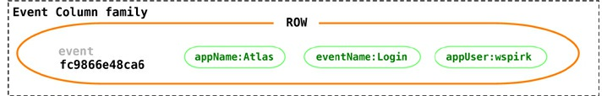
Column Store Database Suitable Use Cases
Event Logging: Column-family databases with their ability to store any data structures are a great choice to store event information, such as application state or errors encountered by the application. Within the enterprise, all applications can write their events to Cassandra with their own columns and the rowkey of the form appname:timestamp. Since we can scale writes, Cassandra would work ideally for an event logging system
Content Management Systems: Blogging Platforms Using column families, you can store blog entries with tags, categories, links, and trackbacks in different columns. Comments can be either stored in the same row or moved to a different keyspace; similarly, blog users and the actual blogs can be put into different column families.

Slide 14
Column Store Database Suitable Use Cases
Counters: Often, in web applications you need to count and categorize visitors of a page to calculate analytics. You can use the CounterColumnType during creation of a column family.
CREATE COLUMN FAMILY visit_counter
WITH default_validation_class=CounterColumnType
AND key_validation_class=UTF8Type AND comparator=UTF8Type;
Once a column family is created, you can have arbitrary columns for each page visited within the web application for every user.
INCR visit_counter['mfowler'][home] BY 1;
INCR visit_counter['mfowler'][products] BY 1;
INCR visit_counter['mfowler'][contactus] BY 1;
Incrementing counters using CQL:
UPDATE visit_counter SET home = home + 1 WHERE KEY='mfowler'

Slide 15
Column Store Database Suitable Use Cases
Expiring Usage: You may provide demo access to users, or may want to show ad banners on a website for a specific time. You can do this by using expiring columns: Cassandra allows you to have columns which, after a given time, are deleted automatically. This time is known as TTL (Time To Live) and is defined in seconds. The column is deleted after the TTL has elapsed; when the column does not exist, the access can be revoked or the banner can be removed.
SET Customer['mfowler']['demo_access'] = 'allowed' WITH ttl=2592000;

Slide 16
Column Store Database Use Cases
Data Warehousing: Column store databases are optimized for data warehousing and business intelligence applications, where large amounts of data need to be analyzed and aggregated. They are often used for analytical queries, such as aggregation and data mining.
OLAP (Online Analytical Processing): Column store databases can handle complex and large queries and calculations which is required in OLAP systems, they are used for multi-dimensional analysis and reporting.
Real-time analytics: Column store databases can handle high-volume, high-velocity data and a high number of concurrent users, which makes them a suitable choice for real-time analytics applications.

Slide 17
Column Store Database Use Cases
Big data: Column store databases can handle large datasets and provide efficient storage and retrieval of data which makes them suitable for big data applications.
Cloud-based analytics: Column store databases can be easily scaled to handle large amounts of data and are designed for high availability, this makes them suitable for cloud-based analytics applications.
IoT: Column store databases can handle a high number of writes and reads, which makes them suited for storing and processing IoT data.
Note: Column store databases are not suitable for all types of use cases. For example, if you need to perform complex data modeling or you need to enforce data integrity constraints, a relational database or a document database may be a better choice.

Slide 18
Column Store Database List
Apache Cassandra: An open-source, distributed, NoSQL database that stores data in a column-family format.
Apache Hbase: An open-source, distributed, NoSQL database that stores data in a column-family format and is modeled after Google’s Bigtable.
Vertica: A commercial, columnar, relational database management system (RDBMS) developed by HP, it’s designed to handle large-scale data warehousing and business intelligence workloads.
MonetDB: An open-source, column-store relational database management system.
Amazon Redshift: A fully managed, petabyte-scale data warehouse service that is part of the Amazon Web Services (AWS) ecosystem.

Slide 19
Column Store Database List
Azure Synapse Analytics (formerly SQL DW): A fully managed, cloud-based data warehouse service that is part of the Microsoft Azure ecosystem.
Google BigQuery: A fully managed, cloud-based data warehouse service that is part of the Google Cloud Platform (GCP) ecosystem.
MariaDB ColumnStore: An open-source, distributed, columnar storage engine for MariaDB.
Infobright: A commercial, column-store, analytic database management system.
ClickHouse: An open-source, column-store database management system that is designed for online analytical processing (OLAP) and real-time analytics.

Slide 20
Advantages of Column Store Database
High performance: Column store databases are optimized for analytical queries and are designed for fast query performance, which can be especially important in data warehousing and business intelligence applications.
Compression: Column store databases use advanced compression techniques, such as run-length encoding or dictionary encoding, which can reduce storage space and improve query performance.
Indexing: Column store databases use column-level indexes, which are optimized for column-based data retrieval, which can improve query performance.
Scalability: Column store databases are often horizontally scalable, which means that they can handle a large amount of data and a high number of concurrent users.
Distributed Systems: Column store databases can be distributed across multiple machines, which allows for high availability and scalability.

Slide 21
Disadvantages of Column Store Database
Limited write performance: Column store databases are designed for read-heavy workloads and may not have the same level of write performance as other types of databases.
Limited data modeling: Column store databases may have limited data modeling capabilities, which can make it difficult to represent complex data structures or relationships.
Limited querying capabilities: Column store databases may have limited querying capabilities, particularly when it comes to performing complex queries or joins.
Lack of support for advanced features: Some column store databases may lack support for advanced features such as full-text search or geospatial indexing.
Limited ACID support: Some column store databases may have limited support for ACID (Atomicity, Consistency, Isolation, Durability) transactions, which can make it difficult to ensure data consistency in certain situations.

Slide 22
When to Use Column Store Database
Queries that involve only a few columns.
Compression but column-wise only.
Clustering queries against a huge amount of data.

Slide 23
When Not to Use Column Store Database
There are problems for which column-family databases are not the best solutions, such as systems that require ACID transactions for writes and reads.
If you need the database to aggregate the data using queries (such as SUM or AVG), you have to do this on the client side using data retrieved by the client from all the rows.
Cassandra is not great for early prototypes or initial tech spikes: During the early stages, we are not sure how the query patterns may change, and as the query patterns change, we have to change the column family design. This causes friction for the product innovation team and slows down developer productivity.
RDBMS impose high cost on schema change, which is traded off for a low cost of query change; in Cassandra, the cost may be higher for query change as compared to schema change.

Slide 24

Cassandra
Cassandra is a NoSQL database which is distributed and scalable. It is provided by Apache.
Apache Cassandra is an open source, distributed, NoSQL database. It presents a partitioned wide column storage model with eventually consistent semantics.
Apache Cassandra was initially designed at Facebook using a staged event-driven architecture (SEDA) to implement a combination of Amazon’s Dynamo distributed storage and replication techniques and Google’s Bigtable data and storage engine model. Dynamo and Bigtable were both developed to meet emerging requirements for scalable, reliable and highly available storage systems, but each had areas that could be improved.
Apache Cassandra is highly scalable, high performance, distributed NoSQL database. Cassandra is designed to handle huge amount of data across many commodity servers, providing high availability without a single point of failure.
Cassandra has a distributed architecture which is capable to handle a huge amount of data. Data is placed on different machines with more than one replication factor to attain a high availability without a single point of failure.

Slide 25
History of Cassandra
Cassandra was developed at Facebook by Avinash Lakshman and Prashant Malik.
It was developed for Facebook inbox search feature.
It was open sourced by Facebook in July 2008.
It was accepted by Apache Incubator in March 2009.
Cassandra is a top level project of Apache since February 2010.
The latest version of Apache Cassandra is 4.1

Slide 26
Cassandra Objectives
NoSQL database.Systems like Cassandra are designed for these challenges and seek the following design objectives:
Full multi-master database replication
Global availability at low latency
Scaling out on commodity hardware
Linear throughput increase with each additional processor
Online load balancing and cluster growth
Partitioned key-oriented queries
Flexible schema

Slide 27
Cassandra Features
Elastic scalability: Cassandra is highly scalable; it allows to add more hardware to accommodate more customers and more data as per requirement.
Always on architecture: Cassandra has no single point of failure and it is continuously available for business-critical applications that cannot afford a failure.
Fast linear-scale performance: Cassandra is linearly scalable, i.e., it increases your throughput as you increase the number of nodes in the cluster. Therefore it maintains a quick response time.
Flexible data storage: Cassandra accommodates all possible data formats including: structured, semi-structured, and unstructured. It can dynamically accommodate changes to your data structures according to your need.

Slide 28
Cassandra Features
Fault tolerant: Cassandra is fault tolerant. Suppose, there are 4 nodes in a cluster, here each node has a copy of same data. If one node is no longer serving then other three nodes can served as per request.
Easy data distribution: Cassandra provides the flexibility to distribute data where you need by replicating data across multiple datacenters.
Transaction support: Cassandra supports properties like Atomicity, Consistency, Isolation, and Durability (ACID).
Fast writes: Cassandra was designed to run on cheap commodity hardware. It performs blazingly fast writes and can store hundreds of terabytes of data, without sacrificing the read efficiency.

Slide 29
Cassandra Architecture
Cassandra was designed to handle big data workloads across multiple nodes without a single point of failure. It has a peer-to-peer distributed system across its nodes, and data is distributed among all the nodes in a cluster.
In Cassandra, each node is independent and at the same time interconnected to other nodes. All the nodes in a cluster play the same role.
Every node in a cluster can accept read and write requests, regardless of where the data is actually located in the cluster.
In the case of failure of one node, Read/Write requests can be served from other nodes in the network.

Slide 30
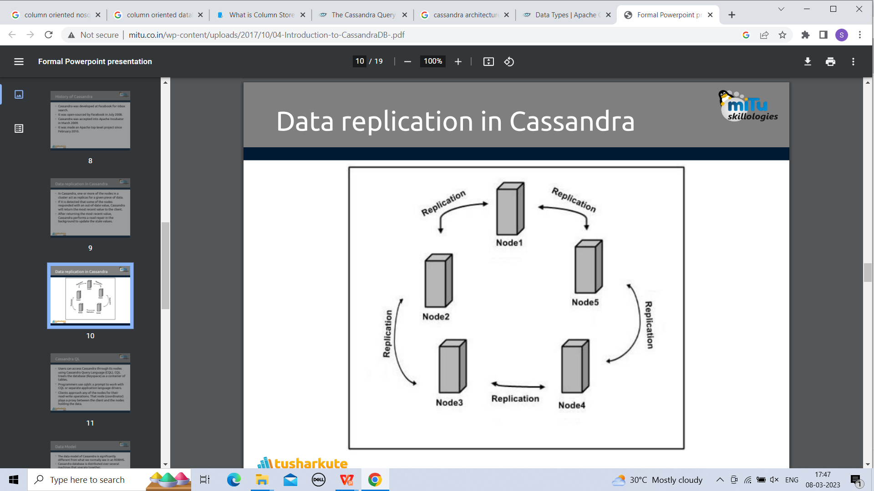
Data replication in Cassandra
In Cassandra, one or more of the nodes in a cluster act as replicas for a given piece of data.
If some of the nodes are responded with an out-of-date value, Cassandra will return the most recent value to the client.
After returning the most recent value, Cassandra performs a read repair in the background to update the stale values.

Slide 31
Components of Cassandra
The main components of Cassandra are:
Node: A Cassandra node is a place where data is stored.
Data center: Data center is a collection of related nodes.
Cluster: A cluster is a component which contains one or more data centers.
Commit log: In Cassandra, the commit log is a crash-recovery mechanism. Every write operation is written to the commit log.
Mem-table: A mem-table is a memory-resident data structure. After commit log, the data will be written to the mem-table. Sometimes, for a single-column family, there will be multiple mem-tables.
SSTable: It is a disk file to which the data is flushed from the mem-table when its contents reach a threshold value.
Bloom filter: These are nothing but quick, nondeterministic, algorithms for testing whether an element is a member of a set. It is a special kind of cache. Bloom filters are accessed after every query.

Slide 32
Cassandra Query Lanaguage
Users can access Cassandra through its nodes using Cassandra Query Language (CQL). CQL treats the database (Keyspace) as a container of tables.
Programmers use cqlsh: a prompt to work with CQL or separate application language drivers.
Clients approach any of the nodes for their read-write operations. That node (coordinator) plays a proxy between the client and the nodes holding the data.

Slide 33
Cassandra Query Lanaguage
Cassandra provides the Cassandra Query Language (CQL), an SQL-like language, to create and update database schema and access data. CQL allows users to organize data within a cluster of Cassandra nodes using:
Keyspace: Defines how a dataset is replicated, per datacenter. Replication is the number of copies saved per cluster. Keyspaces contain tables.
Table: Defines the typed schema for a collection of partitions. Tables contain partitions, which contain rows, which contain columns. Cassandra tables can flexibly add new columns to tables with zero downtime.
Partition: Defines the mandatory part of the primary key all rows in Cassandra must have to identify the node in a cluster where the row is stored. All performant queries supply the partition key in the query.
Row: Contains a collection of columns identified by a unique primary key made up of the partition key and optionally additional clustering keys.
Column: A single datum with a type which belongs to a row.

Slide 34
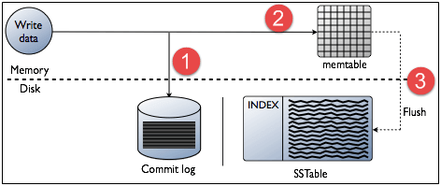
Write Operations
Every write activity of nodes is captured by the commit logs written in the nodes. Later the data will be captured and stored in the mem-table. Whenever the mem-table is full, data will be written into the SStable data file. All writes are automatically partitioned and replicated throughout the cluster. Cassandra periodically consolidates the SSTables, discarding unnecessary data.

Slide 35
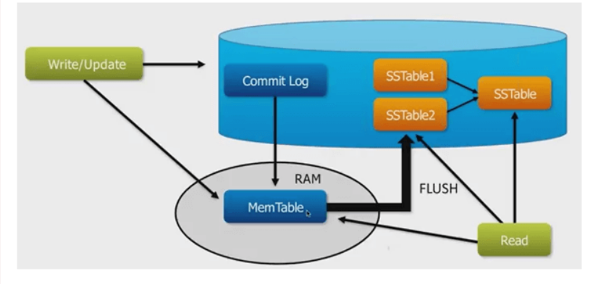
Read Operations
In Read operations, Cassandra gets values from the mem-table and checks the bloom filter to find the appropriate SSTable which contains the required data.
There are three types of read request that is sent to replicas by coordinators.
Direct request
Digest request
Read repair request
The coordinator sends direct request to one of the replicas. After that, the coordinator sends the digest request to the number of replicas specified by the consistency level and checks if the returned data is an updated data.
After that, the coordinator sends digest request to all the remaining replicas. If any node gives out of date value, a background read repair request will update that data. This process is called read repair mechanism.

Slide 36
Cassandra Usecases / Applications
Messaging: Cassandra is a great database which can handle a big amount of data. So it is preferred for the companies that provide Mobile phones and messaging services. These companies have a huge amount of data, so Cassandra is best for them.
Handle high speed Applications: Cassandra can handle the high speed data so it is a great database for the applications where data is coming at very high speed from different devices or sensors.
Product Catalogs and retail apps: Cassandra is used by many retailers for durable shopping cart protection and fast product catalog input and output.
Social Media Analytics and recommendation engine: Cassandra is a great database for many online companies and social media providers for analysis and recommendation to their customers.

Slide 37
Cassandra Additional Features
CQL supports numerous advanced features over a partitioned dataset such as:
Single partition lightweight transactions with atomic compare and set semantics.
User-defined types, functions and aggregates
Collection types including sets, maps, and lists.
Local secondary indices
(Experimental) materialized views
Cassandra explicitly chooses not to implement operations that require cross partition coordination as they are typically slow and hard to provide highly available global semantics. For example Cassandra does not support:
Cross partition transactions
Distributed joins
Foreign keys or referential integrity.

Slide 38
Cassandra Datatypes
Cassandra Built-in Data Types include numeric types, collection types, string types, and binary large objects (BLOBs) for byte-array data.
Cassandra Custom Data Types are classified into native types, collection types, tuple types, user-defined types, and custom types.
Native Types:
ascii ,bigint, blob, boolean, counter, date, decimal, double, duration, float, inet, int , smallint, text, time, timestamp, timeuuid, tinyint, uuid, varchar, varint.
CQL Collection Types include maps, sets, and lists:

Slide 39
Cassandra Data Model
The data model of Cassandra is significantly different from what we normally see in an RDBMS.
Cassandra database is distributed over several machines that operate together.
The outermost container is known as the Cluster. For failure handling, every node contains a replica, nd in case of a failure, the replica takes charge.
Cassandra arranges the nodes in a cluster, in a ring format, and assigns data to them.
Keyspace is the outermost container for data in Cassandra. The basic attributes of a Keyspace in Cassandra are:
Replication factor:
It is the number of machines in the cluster that will receive copies of the same data.
Replica placement strategy:
It is nothing but the strategy to place replicas in the ring. We have strategies such as simple strategy (rack-aware strategy), old network topology strategy (rack-aware strategy), and network topology strategy (datacenter-shared strategy).
Column families:
Keyspace is a container for a list of one or more column families. A column family, in turn, is a container of a collection of rows. Each row contains ordered columns. Column families represent the structure of your data.Each keyspace has at least one and often many column families.

Slide 40
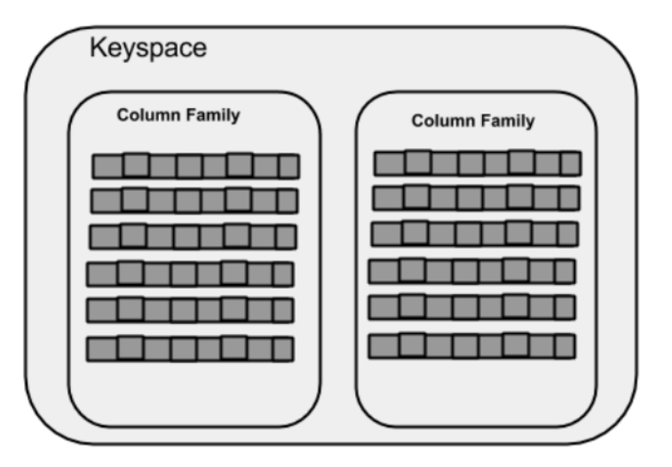
Creating Keyspace
CREATE KEYSPACE Keyspace name WITH replication = {'class': 'SimpleStrategy', 'replication_factor' : 3};

Slide 41
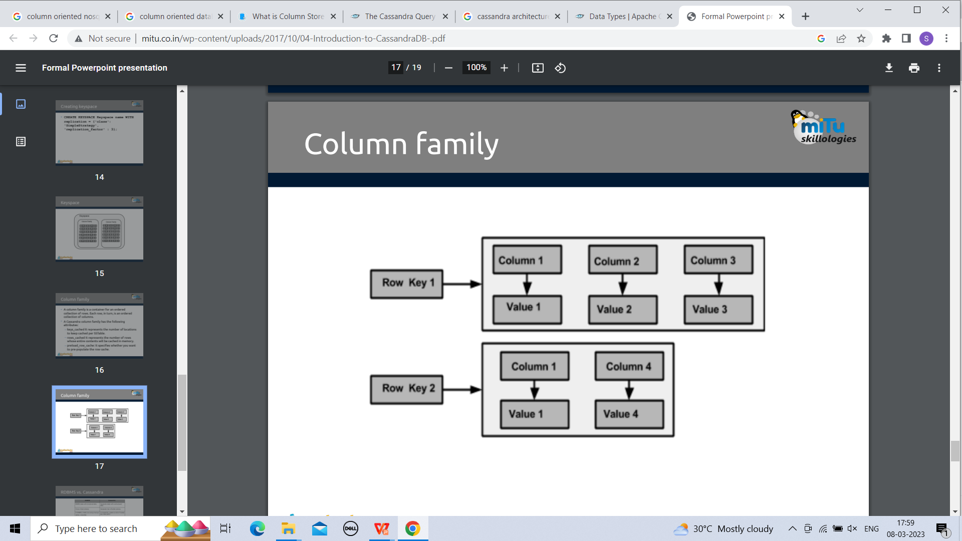
Column family
A column family is a container for an ordered collection of rows. Each row, in turn, is an ordered collection of columns.
A Cassandra column family has the following attributes:
keys_cached It represents the number of locations to keep cached per SSTable.
rows_cached It represents the number of rows whose entire contents will be cached in memory.
preload_row_cache: It specifies whether you want to pre-populate the row cache.

Slide 42
Cassandra vs RDBMS
Cassandra | RDBMS
Cassandra is used to deal with unstructured data. | RDBMS is used to deal with structured data.
Cassandra has flexible schema. | RDBMS has fixed schema.
In Cassandra, a table is a list of "nested key-value pairs". (Row x Column Key x Column value) | In RDBMS, a table is an array of arrays. (Row x Column)
In Cassandra, keyspace is the outermost container which contains data corresponding to an application. | In RDBMS, database is the outermost container which contains data corresponding to an application.
In Cassandra, tables or column families are the entity of a keyspace. | In RDBMS, tables are the entities of a database.
In Cassandra, row is a unit of replication. | In RDBMS, row is an individual record.
In Cassandra, column is a unit of storage. | In RDBMS, column represents the attributes of a relation.
In Cassandra, relationships are represented using collections. | In RDBMS, there are concept of foreign keys, joins etc.

Slide 43
Cassandra Data Modeling Tools
Hackolade is a data modeling tool that supports schema design for Cassandra and many other NoSQL databases. Hackolade supports the unique concepts of CQL such as partition keys and clustering columns, as well as data types including collections and UDTs. It also provides the ability to create Chebotko diagrams.
Kashlev Data Modeler is a Cassandra data modeling tool that automates the data modeling methodology described in this documentation, including identifying access patterns, conceptual, logical, and physical data modeling, and schema generation. It also includes model patterns that you can optionally leverage as a starting point for your designs.
DataStax DevCenter is a tool for managing schema, executing queries and viewing results. While the tool is no longer actively supported, it is still popular with many developers and is available as a free download. DevCenter features syntax highlighting for CQL commands, types, and name literals. DevCenter provides command completion as you type out CQL commands and interprets the commands you type, highlighting any errors you make. The tool provides panes for managing multiple CQL scripts and connections to multiple clusters. The connections are used to run CQL commands against live clusters and view the results.
IDE Plugins - There are CQL plugins available for several Integrated Development Environments (IDEs), such as IntelliJ IDEA and Apache NetBeans. These plugins typically provide features such as schema management and query execution.

Slide 44
Cassandra Setup and Installation
Apache Cassandra and Datastax enterprise is used by different organization for storing huge amount of data.
Before installing Apache Cassandra, you must have the following things:
You must have datastax community edition.
JDK must be installed.
Platform should be Window.

Slide 45
Cassandra Inserting and querying
The API for Cassandra is CQL, the Cassandra Query Language. To use CQL, you will need to connect to the cluster, using either:
cqlsh, a shell for CQL
a client driver for Cassandra
CQLSH
cqlsh is a command-line shell for interacting with Cassandra using CQL. It is shipped with every Cassandra package, and can be found in the bin directory alongside the cassandra executable. It connects to the single node specified on the command line. For example:
Ex: $ bin/cqlsh localhost
Client drivers
A lot of client drivers are provided by the Community and a list of known drivers is provided

